Slide 1
IST 707: Applied Machine Learning
Unit 2 Data Preparation

Slide 2
Study Guide Key Concepts
Make sure you understand the following key concepts by the end of Week 2
Data set types
Records, transactions, images, sequences, audios
Variable types
Nominal/categorical, Ordinal, Numeric (interval and ratio)
Data quality issues
Outliers, missing values, duplicate data
Data summary and visualization
Data transformation

Slide 3
DATA TYPES

Slide 4
Data set types
Record data: data in the tabular format
each row is a data example
each column is an attribute
Most common type of data set
name | highest degree | age | blood type
Jane | Middle School | 25 | A
John | High School | 30 | B
Amy | College | 34 | O
Larry | Grad School | 31 | AB

Slide 5

Non-record data
Notes:
Imagine that we want to collect the homepage of every university in US and explore if these homepages are similar or different. Eg. Which university has the most similar homepage as Syracuse in terms of content.

Slide 6
Non-record data: Text documents
Some data sets are not born as record data, but can be converted to record format.
Notes:
with possible information loss during conversion
Convert text documents to record data by counting word frequencies

Slide 7
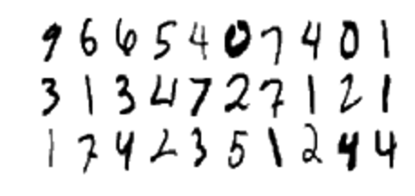
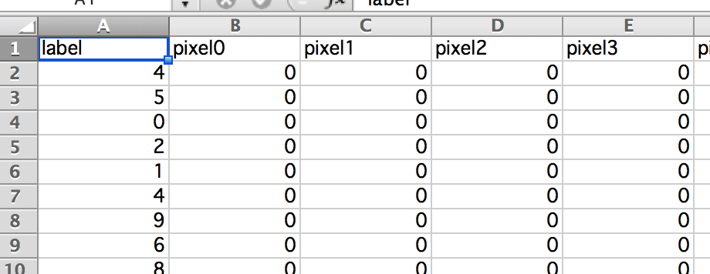

Image data
https://www.kaggle.com/c/digit-recognizer
Each image is 28*28 pixels =784 in total. Each pixel has a single pixel-value [0, 255] associated with it, indicating the lightness or darkness of that pixel, with higher numbers meaning darker.

Slide 8
Sequence data
Notes:
Audios and videos too
Genomic sequence data: the main goal of analysis is to predict similarities in the nucleotides sequences

Slide 9
Transaction data

Slide 10
Transaction data
Converted to record data
TID | Bread? | Coke? | Milk? | Diaper? | Beer?
1 | 1 | 1 | 1 | 0 | 0
2 | 1 | 0 | 0 | 0 | 1
3 | 0 | 1 | 1 | 1 | 1
4 | 1 | 0 | 1 | 1 | 1
5 | 0 | 1 | 1 | 1 | 0

Slide 11
Sparse matrix
Most values in the matrix are “0”.
Too many columns
Too few with non-zero values
TID | Bread? | Coke? | Milk? | Diaper? | Beer?
1 | 1 | 1 | 1 | 0 | 0
2 | 1 | 0 | 0 | 0 | 1
3 | 0 | 1 | 1 | 1 | 1
4 | 1 | 0 | 1 | 1 | 1
5 | 0 | 1 | 1 | 1 | 0

Slide 12
Storage of sparse matrix
Requires less space
TID | Bread? | Coke? | Milk? | Diaper? | Beer?
1 | 1 | 1 | 1 | 0 | 0
2 | 1 | 0 | 0 | 0 | 1
3 | 0 | 1 | 1 | 1 | 1
4 | 1 | 0 | 1 | 1 | 1
5 | 0 | 1 | 1 | 1 | 0
Requires more space

Slide 13
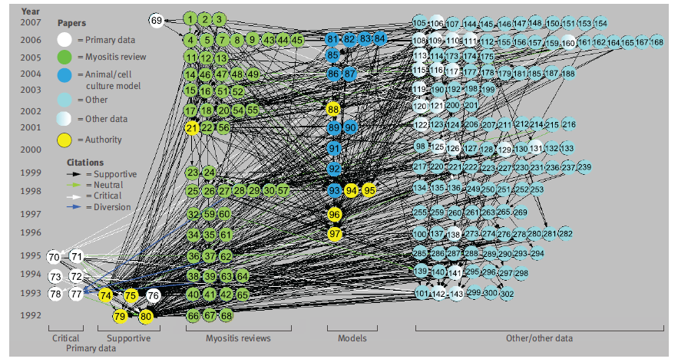
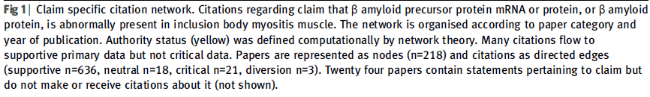
Network data
Steven G. Greenberg (2009). How citation distortions create unfound authority: analysis of citation network. BMJ 2009; 339: b2680 http://dx.doi.org/10.1136/bmj.b2680
Notes:
Requires network analysis tool

Slide 14
Review of data set types
Record data
Non-record data
Text data
Image data
Sequence data
Transaction data
Network data

Slide 15
DATA PREPARATION

Slide 16
How to Prepare Data for Analysis
Understand the meaning of data
Assess the quality of data
Transform data for analysis if necessary

Slide 17
DATA TYPES

Slide 18
Attribute
An attribute is a property or characteristic of an object.
Sometimes, we refer to this as a variable.
The value of an attribute can be different for different data examples
Data example: person | Attribute 1: highest degree | Attribute 2: age | Attribute 3: blood type
Jane | Middle School | 25 | A
John | High School | 30 | B
Amy | College | 34 | O
Larry | Grad School | 31 | AB

Slide 19
Attribute types
Four main types of attributes
Nominal
Ordinal
Interval
Ratio

Slide 20
Nominal attributes
Definition: the values of a nominal attributes are just “names”.
name | highest degree | age | blood type
Jane | Middle School | 25 | A
John | High School | 30 | B
Amy | College | 34 | O
Larry | Grad School | 31 | AB

Slide 21
Ordinal attribute
An ordinal attribute describes data objects in a qualitative, ordered way.
name | highest degree | age | blood type
Jane | Middle School | 25 | A
John | High School | 30 | B
Amy | College | 34 | O
Larry | Grad School | 31 | AB

Slide 22
Numeric
Numbers that describe a measurable quantity
“how many”
“how much”
name | highest degree | age | blood type
Jane | Middle School | 25 | A
John | High School | 30 | B
Amy | College | 34 | O
Larry | Grad School | 31 | AB

Slide 23
Significant digits
Use a scale to measure people’s weight
Assume the scale is accurate to 0.1 lb
If a person weighs 3 times and got 150.0, 150.4, and 150.6, is the average weight 150.3333?
No, because the scale is only accurate to 0.1 lbs.
http://www.chem.sc.edu/faculty/morgan/resources/sigfigs/

Slide 24
Significant digits in R
> a=c(150.0,150.4,150.6)
> mean(a)
[1] 150.3333
> signif(mean(x), digits=4)
[1] 150.3

Slide 25
Interval vs. Ratio
Whether or not zero is the origin
Yes: ratio
E.g. Kelvin scale of temperature, in which “0” means the lowest possible temperature. At this temperature all atoms stop moving.
No: interval
E.g. Celsius or Fahrenheit scale of temperature, in while “0” is NOT the lowest temperature.

Slide 26
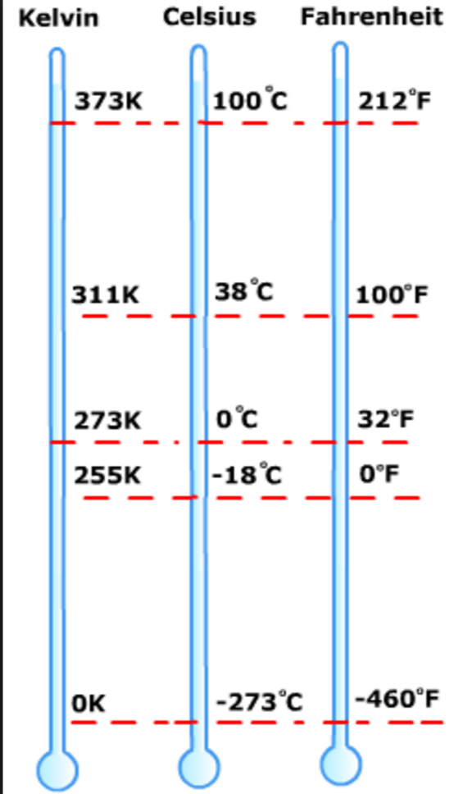
Ratio vs. Interval
A temperature of Kelvin 200 degree is twice as warm as Kelvin 100 degree
A temperature of Fahrenheit 200 degree is NOT twice as warm as Fahrenheit 100 degree

Slide 27
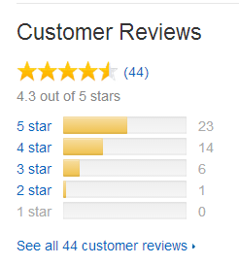
Ordinal variables
Sometimes we treat ordinal variable as either nominal or numeric
Customer_id | rating
1 | *
2 | *****
3 | **
4 | ***
5 | ****
6 | **
… | …
average | ?

Slide 28
Using Orange / Python

Slide 29
Data Type Conversion
When reading data the tool might not interpret the data types correctly.
Every tool provides ways to deal with this
Notes:
Import data into R
Read .csv file.
Take titanic data as an example:
titanic <- read.csv("/Users/byu/Desktop/Data/titanic-train.csv", na.string = c(“”)) # Use the path to the depository where you save the csv file. “na.string” is used to specify missing values.
or
titanic <- read.table("/Users/byu/Desktop/Data/titanic-train.csv", sep=",", header=TRUE, na.string = c("")) # “sep” indicates the field separator character
Note: Other format data files may need additional package to import, for example:
Read .xlsx file
Install.packages(“xlsx”) # install the package
library(xlsx)
titanic=read.xlsx("/Users/byu/Desktop/Data/titanic-train.xlsx", 1) # “1” is the sheet index
Examine data
List the structure of the data
str(titanic)
# It will show the number of total observations (rows) and variables (columns), as well as the name and type (e.g. integer, factor, numeric) of each variable.
Note: R treats factors as nominal variables and ordered factors as ordinal variables.

Slide 30
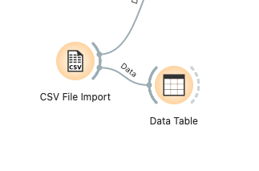
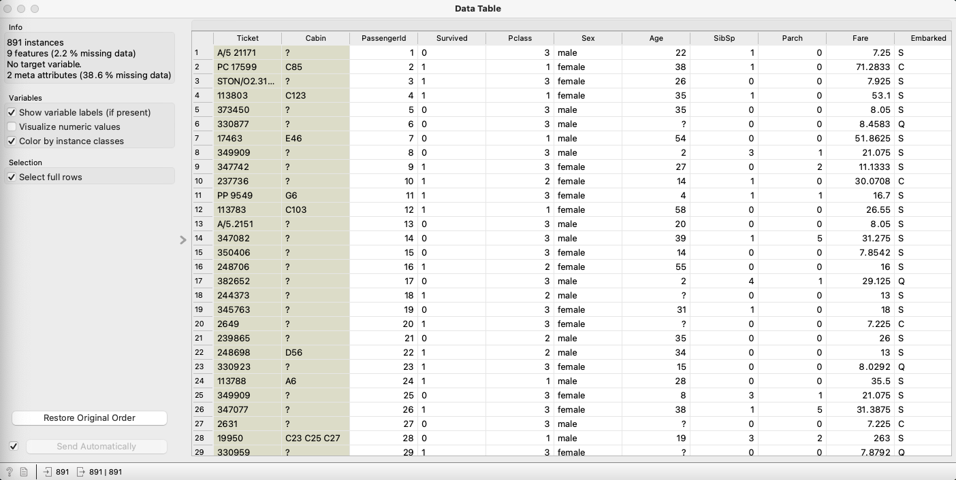

Load and examine Data in Orange
Note that some variables are integers, but should really be interpreted as categorical

Slide 31
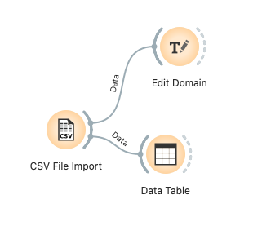
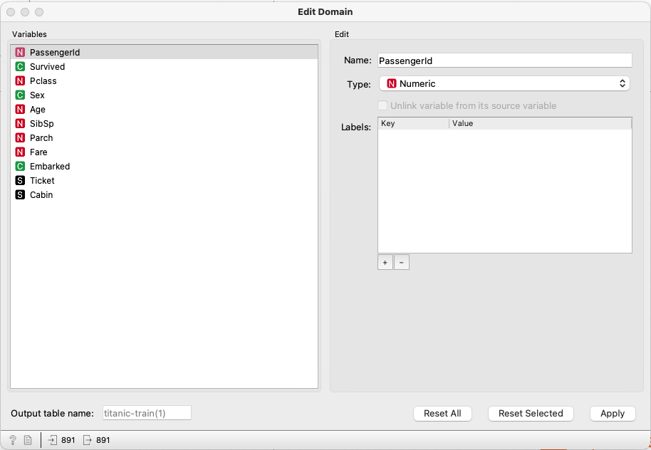
Editing Variables in Orange
Orange is pretty smart about some things! But you’ll probably have to edit a few variables.
Notes:
Note that all categorical variables are ordinal by default in Orange. This can be ignored.

Slide 32
Output
'data.frame': 891 obs. of 11 variables:
$ PassengerId: int 1 2 3 4 5 6 7 8 9 10 ...
$ Survived : int 0 1 1 1 0 0 0 0 1 1 ...
$ Pclass : int 3 1 3 1 3 3 1 3 3 2 ...
$ Sex : Factor w/ 2 levels "female","male": 2 1 1 1 2 2 2 2 1 1 ...
$ Age : num 22 38 26 35 35 NA 54 2 27 14 ...
$ SibSp : int 1 1 0 1 0 0 0 3 0 1 ...
$ Parch : int 0 0 0 0 0 0 0 1 2 0 ...
$ Ticket : Factor w/ 681 levels "110152","110413",..: 524 597 670 50 473 345 133 ...
$ Fare : num 7.25 71.28 7.92 53.1 8.05 ...
$ Cabin : Factor w/ 147 levels "A10","A14","A16",..: NA 82 NA 56 NA NA 130 NA ...
$ Embarked : Factor w/ 3 levels "C","Q","S": 3 1 3 3 3 2 3 3 3 1 ...

Slide 33
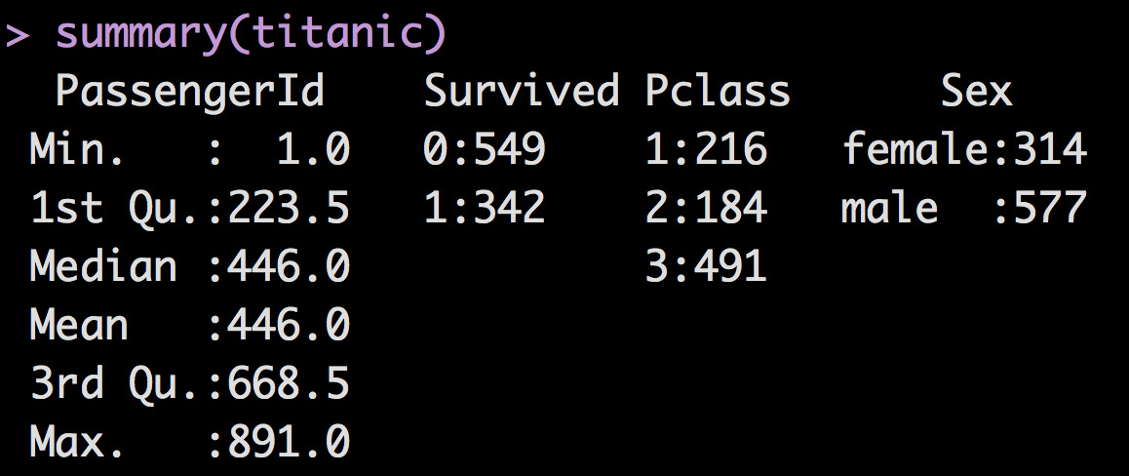
Problem with wrong data type
When R mis-interpreted nominal variable “PassengerId” as numeric, it would calculate the mean and variance of passenger ids, which does not make sense.

Slide 34
Convert data type in R
R treats nominal variables as “factors”
> titanic$Survived=factor(titanic$Survived)
> str(titanic)
Output:
…
$ Survived : Factor w/ 2 levels "0","1": 1 2 2 2 1 1 1 1 2 2 ...
…

Slide 35
Convert data type in R
R treat ordinal variables as “ordered factors”
> titanic$Pclass=ordered(titanic$Pclass)
> str(titanic)
Output:
…
$ Pclass : Ord.factor w/ 3 levels "1"<"2"<"3": 3 1 3 1 3 3 1 3 3 2 ...
…

Slide 36
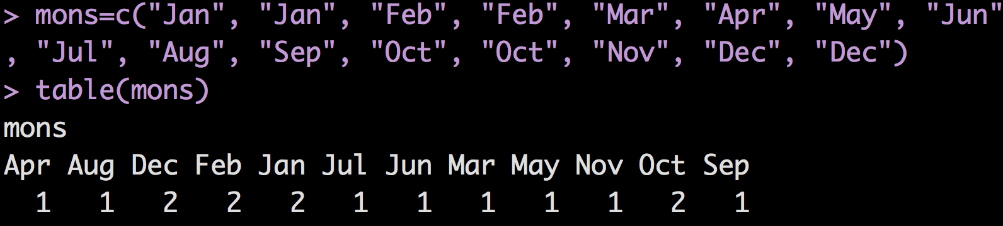
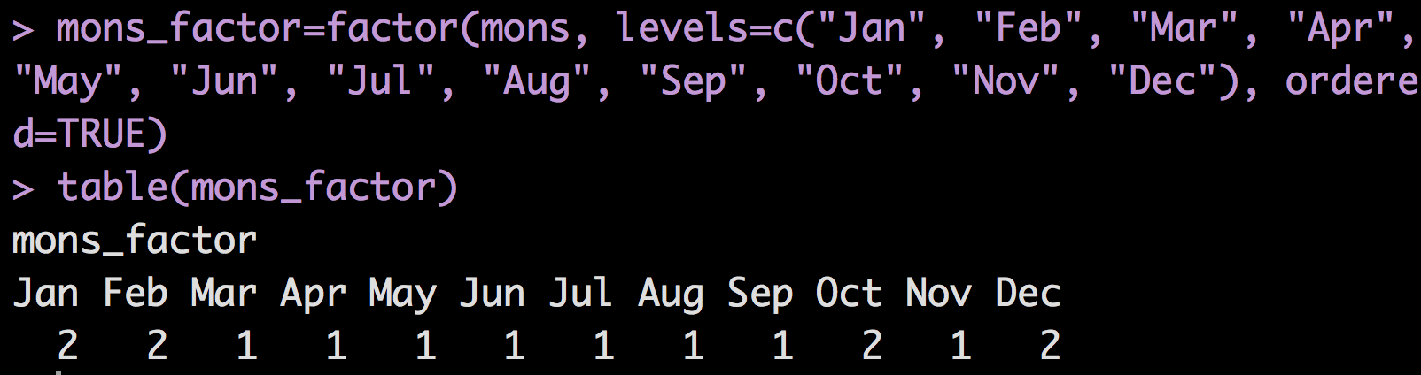
Ordered factor in R
Month defined as a list
Month defined as ordered factor
Notes:
Note: quotation mark may need to change when directly copy over to R
Other sources:
http://www.statmethods.net/input/datatypes.html
http://www.stat.berkeley.edu/~s133/factors.html

Slide 37
Data Quality

Slide 38
Data quality issues
Noise
Outliers
Missing values
Duplicate data

Slide 39
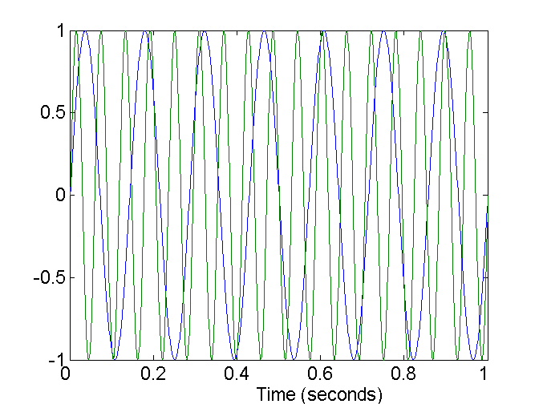
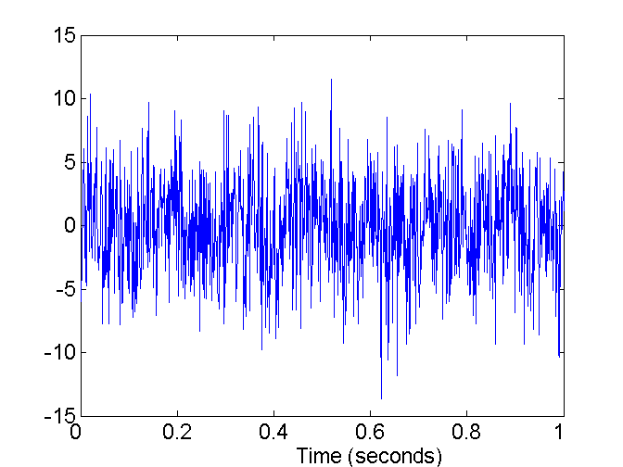
Noise
Noise refers to modification of original values
Examples: distortion of a person’s voice when talking on a poor-quality phone and “snow” on television screen
Two Sine Waves
Two Sine Waves + Noise
Notes:
Smoothing techniques
Fog in images
Orange doesn’t have great support for smoothing

Slide 40

Outliers
Outliers are data objects with characteristics that are considerably different than most of the other data objects in the data set
E.g. 250 would be an outlier for variable “people’s age”
Notes:
For example, collect people’s age, 250 would be an outlier as no one has been found to live that long.
Note that orange provides tools for removing outliers,

Slide 41
Outliers should be detected and analyzed carefully
Each year satellites measure the ozone level over Antarctica.
In the early 1980s, however, scientists were so astounded in detecting a dramatic seasonal drop in ozone levels over Antarctica by a fly over that they spent two years rechecking their satellite data.
They discovered that satellites had dutifully been recording the ozone collapse but the computers had not raised an alert because they were programmed to reject such extreme data as anomalies.
http://www.stat.wmich.edu/s160/book/node8.html
Notes:
Not a trivial decision of what counts as outlier,

Slide 42
Missing Values
Why are values missing?
Information is not collected (e.g., people decline to give their age and weight)
Attributes may not be applicable to all cases (e.g., annual income is not applicable to most children)
Handling missing values
Eliminate Data Objects
Ignore the Missing Value During Analysis
Estimate Missing Values and replace them
Notes:
Deal with missing data
Find out missing value
is.na(titanic) # Returns True and False. True represents missing value
is.na(titanic$Age) # List missing value for specific attribute
complete.cases(titanic) # Returns a logical vector indicating which cases are complete. True represents NON missing value
# list rows of data that do NOT have missing values
titanic[complete.cases(titanic),] # The square brackets indicates the index of selected data with format [row, column].
nrow(titanic[complete.cases(titanic),])
# list rows of data that have missing values titanic[!complete.cases(titanic),] # The exclamation mark means NOT
# cout how many missing values in a column
view(titanic)
length(which(!is.na(titanic$Age)))
Estimate missing value
Taking attribute “age” for example, one way is to replace missing values with the average age.
titanic$Age[is.na(titanic$Age)] <- mean(titanic$Age, na.rm = TRUE)
Ignore the Missing Value During Analysis
titanic <- titanic[complete.cases(titanic),]
or
titanic <- na.omit(titanic)

Slide 43
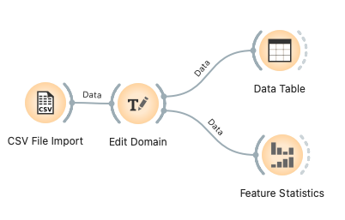
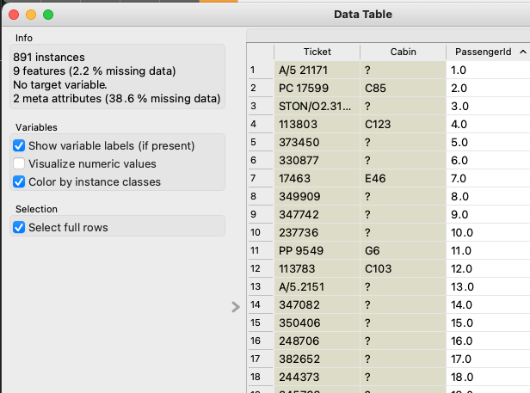
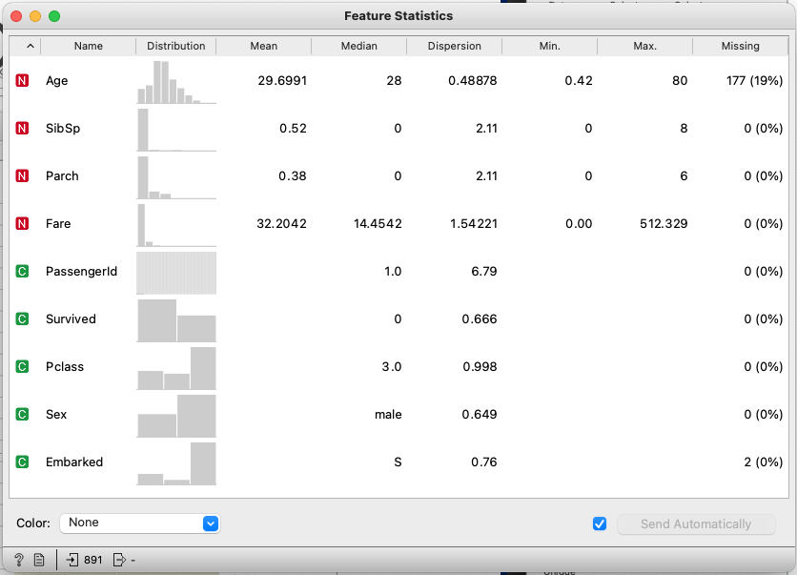

Check missing values in Orange
Question marks are missing values

Slide 44
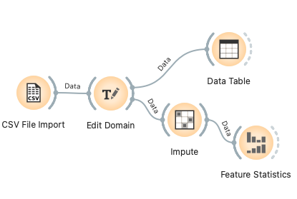
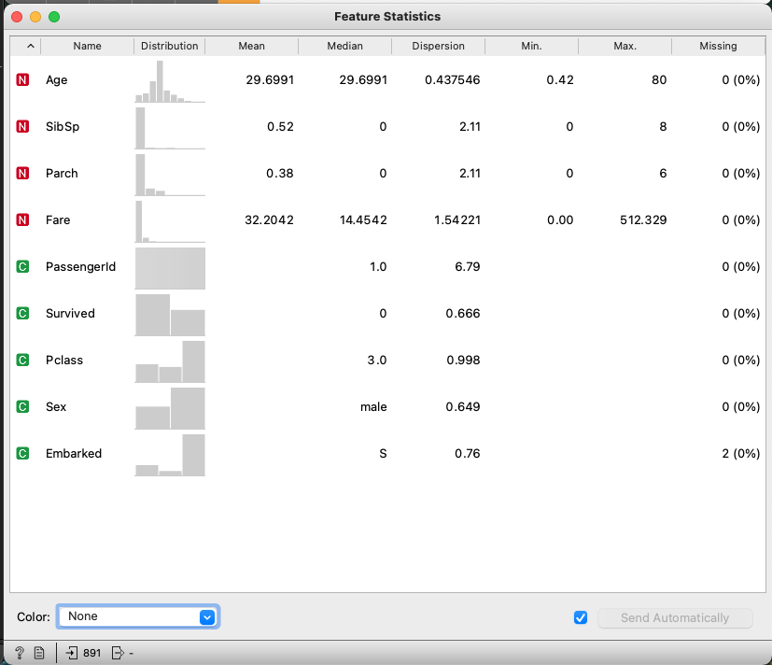
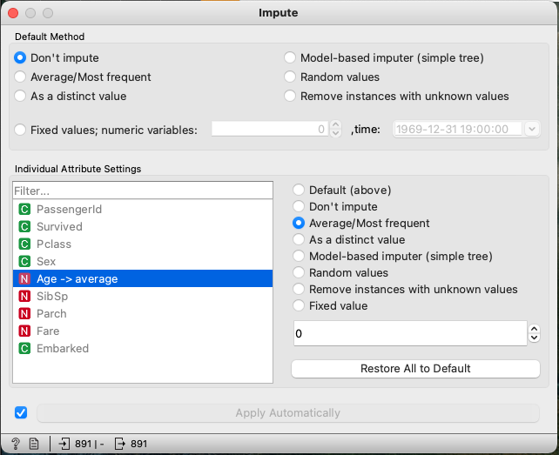
“Impute” data
We can use Orange to replace null values with something else – like the mean

Slide 45
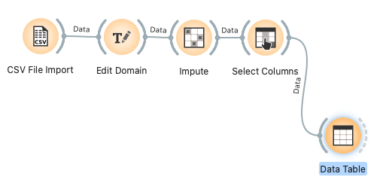
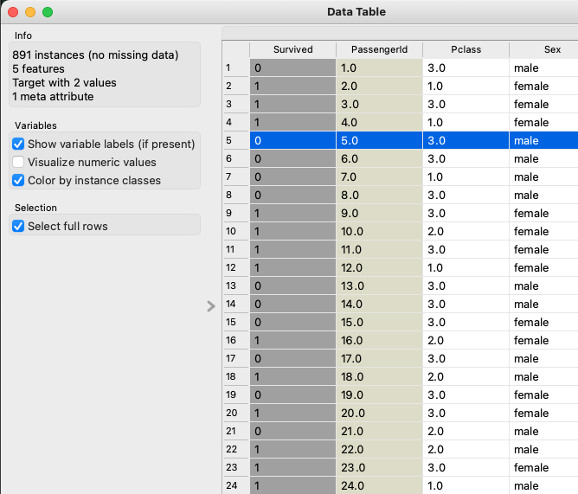
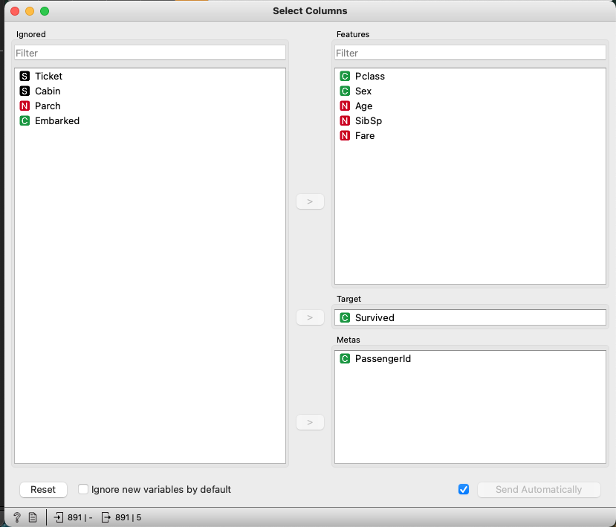


Drop sparse variables
Orange let’s you select columns that you’re interested in as well as select “meta” columns (used primarily to identify cases) and “target” columns (for prediction).

Slide 46
Duplicate Data
Data set may include data objects that are duplicates, or almost duplicates of one another
Major issue when merging data from heterogeous sources
Examples:
Same person with multiple email addresses
Data cleaning
Process of dealing with duplicate data issues
Notes:
Identify duplicate data
duplicated(titanic) # Returns True or False. True represents duplicated values.

Slide 47
An example of duplicate data
An Amazon Mechanical Turk worker set up two accounts and finished a task twice in order to get double payment.
Two identical records were sent to the data collector.
How to identify them?
Check IP address
Compare similarity between records
Notes:
Two users, like a couple might share a computer and thus share the IP address, but their answers should not be highly similar

Slide 48
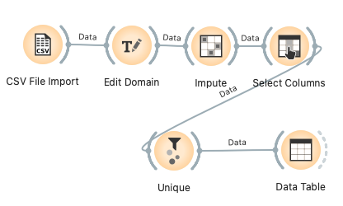
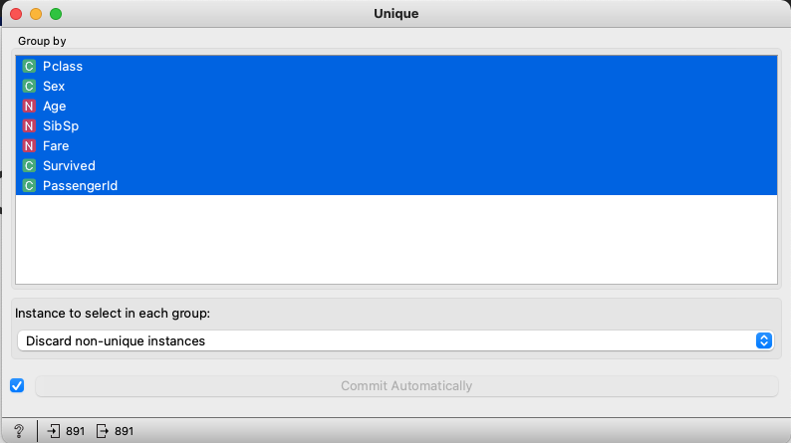

Remove duplicated rows in Orange
No duplicates found!

Slide 49
Summary: data quality issues
Noise
Outliers
Missing values
Duplicate data

Slide 50
Interacting with Python

Slide 51
Injecting Python into Orange
The Python Script widget in Orange let’s you inject arbitrary Python commands into a workflow.
There are two critical commands if you want to use pandas (which is the easiest way to wrangle data in Python).
Notes:
For numerical attribute “Age”:
mean(titanic$Age)
median(titanic$Age)
freq=table(titanic$Age) # frequency distribution
table(titanic$Age)[which.max(table(titanic$Age))] # mode
var(titanic$Age) # variance
sd(titanic$Age) # standard deviation
max(titanic$Age)
min(titanic$Age)
range <- max(titanic$Age) - min(titanic$Age)
qt <- quantile(titanic$Age, na.rm=TRUE) # quartile, remove missing values
IQR=qt[['75%']]-qt[['25%']] # Interquartile range
summary(titanic)
# It will show the count number of individual value for factor variables and minimum, maximum, and mean value for numeric variables.
Count the number for factors
table(titanic$Sex) # It will show the number of female and male respectively.
Summary
summary(titanic)
# It will show the count number of individual value for factor variables and minimum, maximum, and mean value for numeric variables.

Slide 52
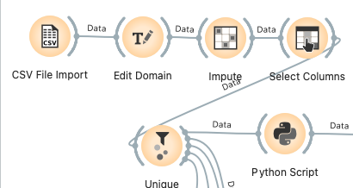
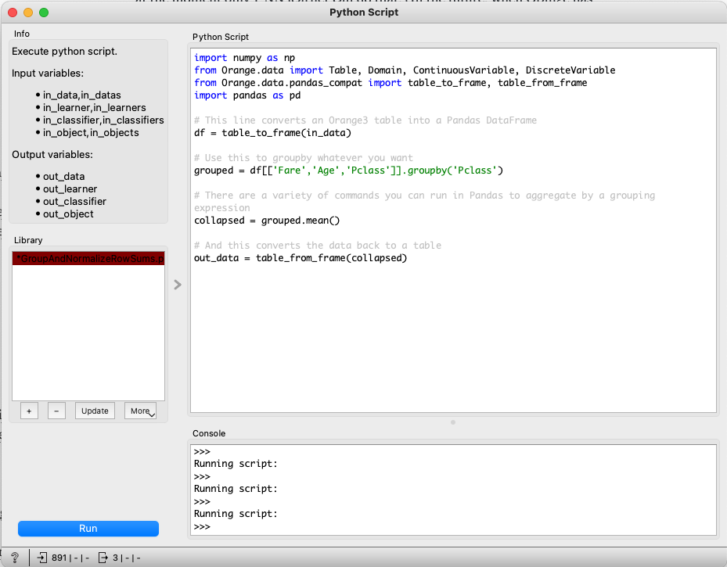


Slide 53
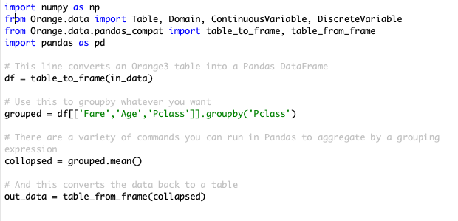
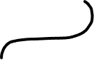
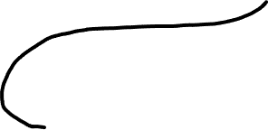
Pulling data in from Orange and transform into a Pandas dataframe
Pulling data out of a Pandas dataframe and transforming it back into and Orange data table

Slide 54
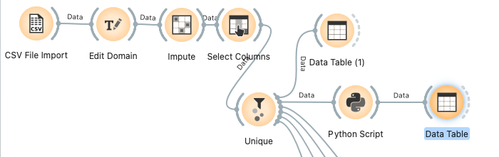
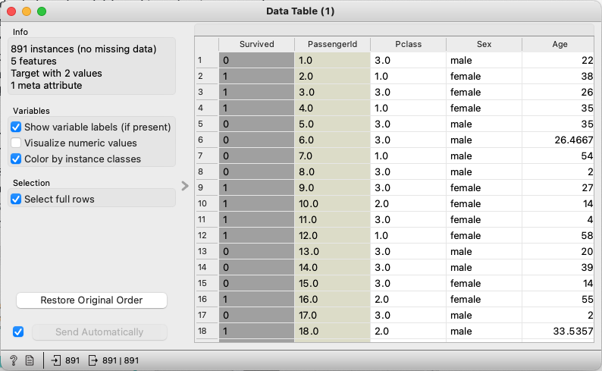
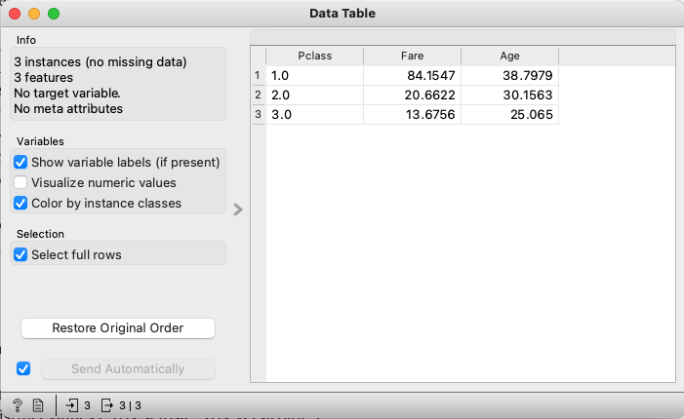
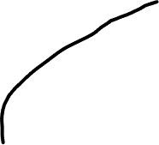
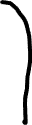

Slide 55
Data Exploration

Slide 56
Summary statistics
Common summary statistics
Central tendency of data
Data spread
Different statistic measures for different variable types
Numeric
Nominal

Slide 57
Numeric Variables
Central tendency
Mean
Median
Mode
Data spread
Standard deviation
Variance
Min, max, quartiles
Notes:
For numerical attribute “Age”:
mean(titanic$Age)
median(titanic$Age)
freq=table(titanic$Age) # frequency distribution
table(titanic$Age)[which.max(table(titanic$Age))] # mode
var(titanic$Age) # variance
sd(titanic$Age) # standard deviation
max(titanic$Age)
min(titanic$Age)
range <- max(titanic$Age) - min(titanic$Age)
qt <- quantile(titanic$Age, na.rm=TRUE) # quartile, remove missing values
IQR=qt[['75%']]-qt[['25%']] # Interquartile range
summary(titanic)
# It will show the count number of individual value for factor variables and minimum, maximum, and mean value for numeric variables.
Count the number for factors
table(titanic$Sex) # It will show the number of female and male respectively.
Summary
summary(titanic)
# It will show the count number of individual value for factor variables and minimum, maximum, and mean value for numeric variables.

Slide 58
Example: Data spread
Range: max-min
Variance /standard deviation
Quartile: Q1 (25%), Q2 (50%), Q3 (75%), Q4 (100%)
E.g. temperature=[55,55,56,58,60,60,60,61,70,72,74]
Interquartile range (IQR): Q3-Q1=70-56=14
min
Q1
median
Q3
max
IQR

Slide 59
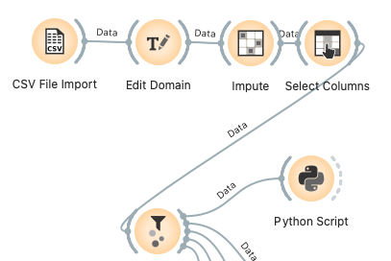
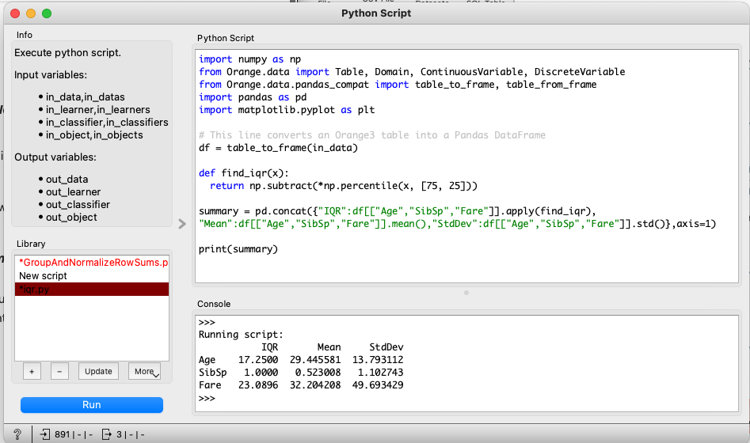

Python Example: Summarizing Numeric Variables

Slide 60
Data visualization
Complementary approach for data analysis in a visual way.
Basic tools for numeric variables
Histogram: show distribution of one variable
Boxplot: use five key values to show distribution
Scatterplot: plot relationship between two variables
Basic tools for nominal variables
Pie chart or bar chart to show frequencies
Cross-tab to show relationship between two variables
Notes:
Visualization with R
# Histogram
hist(titanic$Age) # Note: the variable must be numeric
# Boxplot
boxplot(titanic$Age)
qt = quantile(titanic$Age, na.rm=TRUE) # quartile, remove missing values
IQR=qt[['75%']]-qt[['25%']] # Interquartile range
# Scatterplot
plot(titanic$Age, titanic$Fare)
# Crosstab
titanic.tab=table(titanic$Sex, titanic$Survived)
# Pie chart
pie(table(titanic$Sex))

Slide 61
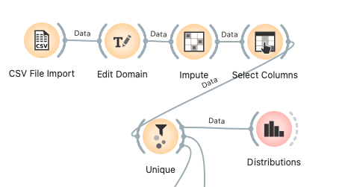
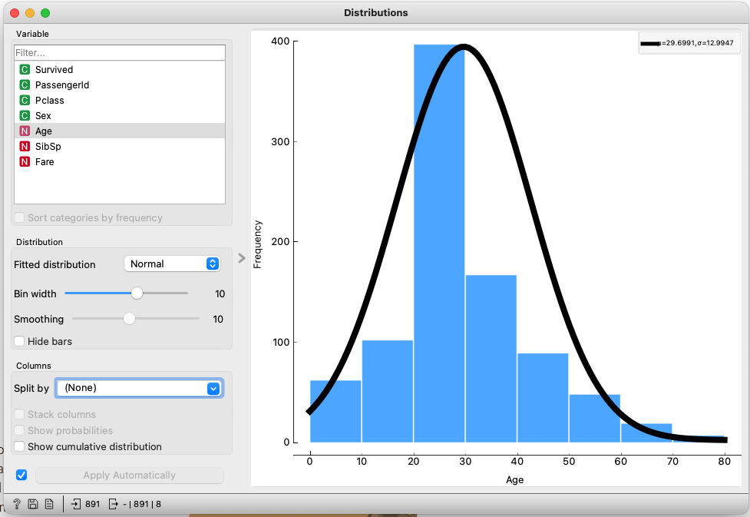
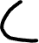
Histograms & Distributions
Notes:
Visualization with R
# Histogram
hist(titanic$Age) # Note: the variable must be numeric
# Boxplot
boxplot(titanic$Age)
qt = quantile(titanic$Age, na.rm=TRUE) # quartile, remove missing values
IQR=qt[['75%']]-qt[['25%']] # Interquartile range
# Scatterplot
plot(titanic$Age, titanic$Fare)
# Crosstab
titanic.tab=table(titanic$Sex, titanic$Survived)
# Pie chart
pie(table(titanic$Sex))

Slide 62
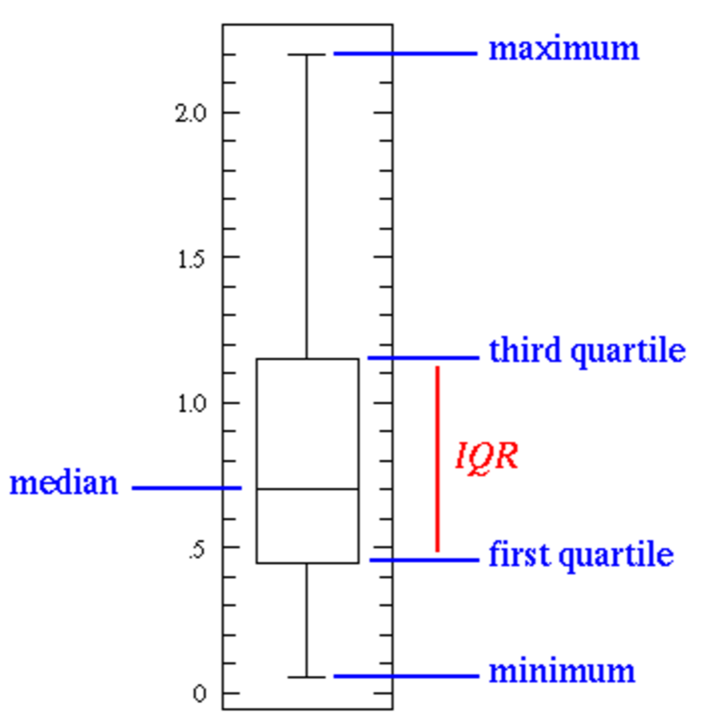
Boxplot
Five values of boxplot
Bottom of box: Q1
Top of box Q3
Band near the middle of box: Median
Upper wisker =min(max, Q3+1.5IQR)
Lower wisker=max(min, Q1-1.5IQR)
use visualization for outlier detection
http://www.stat.wmich.edu/s160/book/node8.html
http://www.r-bloggers.com/about-boxplot/
Notes:
# Boxplot
boxplot(titanic$Age)
qt = quantile(titanic$Age, na.rm=TRUE) # quartile, remove missing values
IQR=qt[['75%']]-qt[['25%']] # Interquartile range

Slide 63
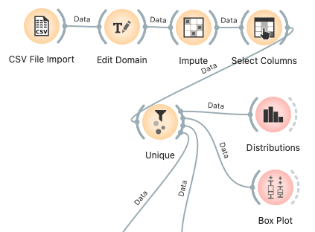
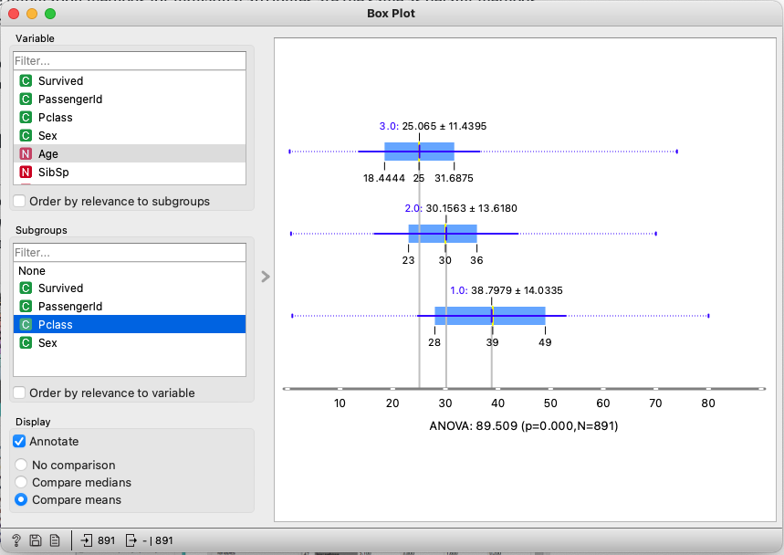

Boxplot

Slide 64
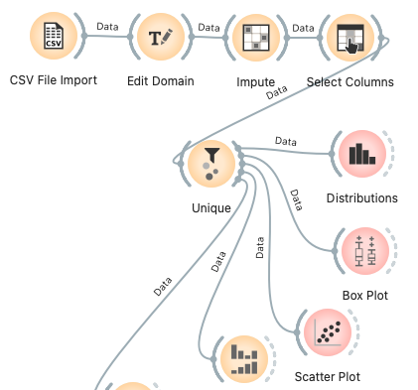
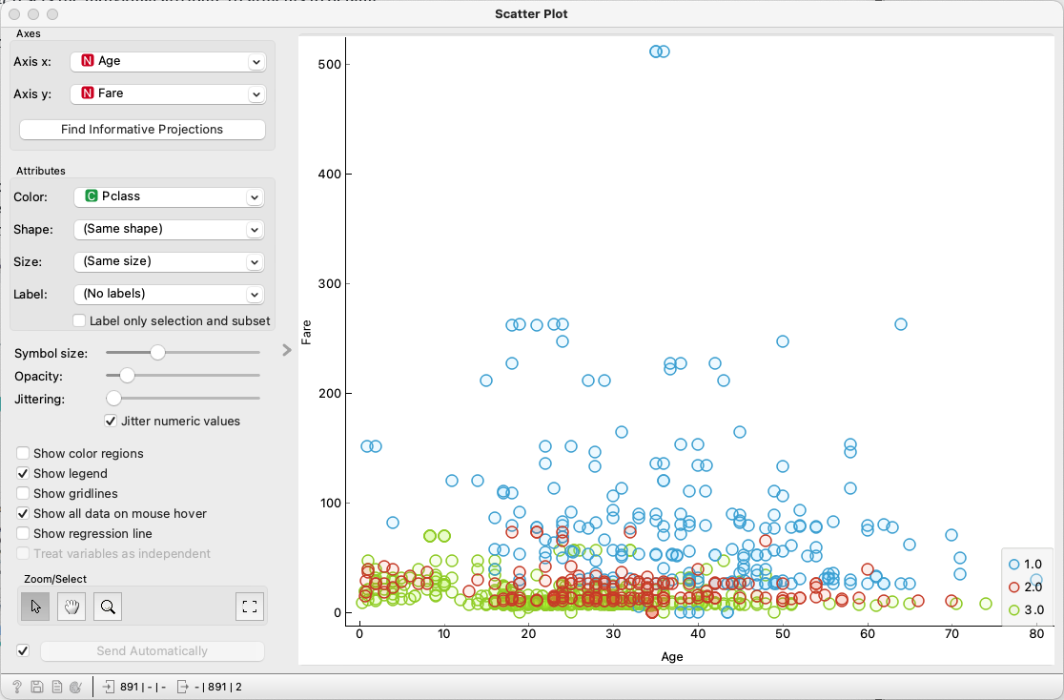

Scatterplot two numeric variables

Slide 65
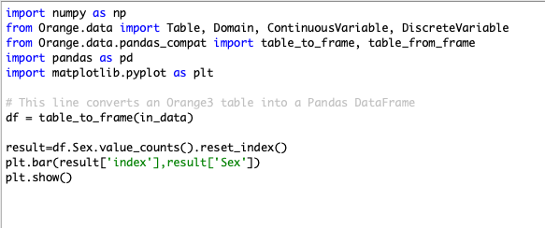
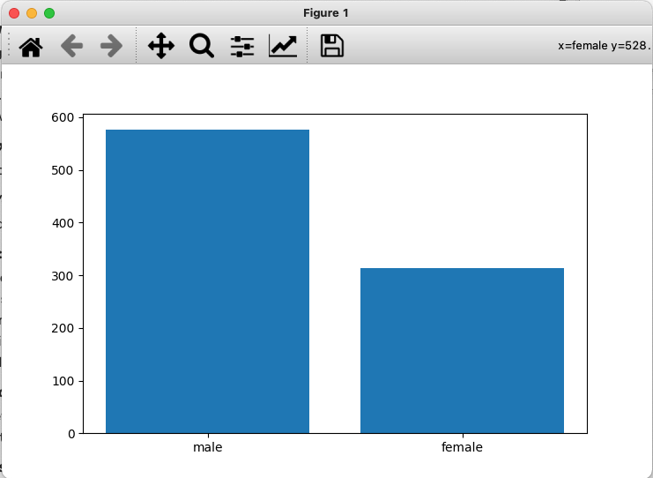
Python Example: Tabulating Nominal Variables

Slide 66
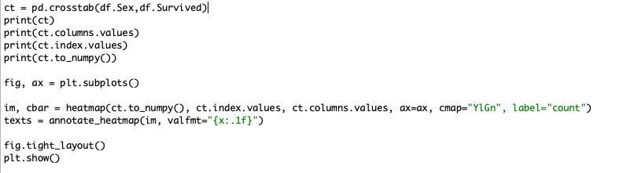
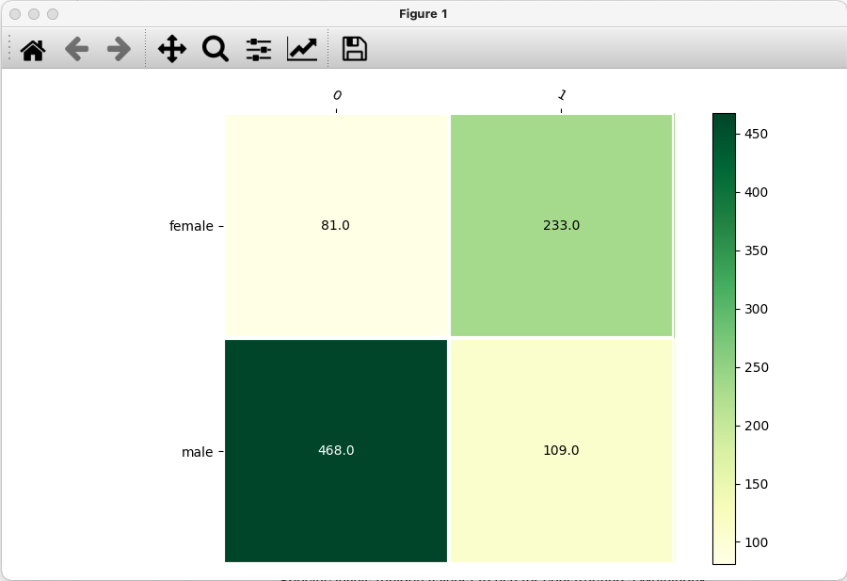
Python Example: Heatmap
(Additional function definitions omitted – see blackboard)
Notes:
Note that you can incorporate the seaborn library and use that for plotting instead! Use the “add-ons” menu

Slide 67
Data Transformation

Slide 68
Data transformation
Aggregation
Attribute Transformation
Dimensionality Reduction and feature selection (covered in future weeks)

Slide 69
Aggregation
Combining two or more rows or columns into a single row or column
Purpose
Data reduction
All test scores merged into one total score
Change of scale
Cities aggregated into regions, states, countries, etc
More “stable” data
Aggregated data tends to have less noise
Notes:
Zoom in and out
Different level of analysis
Aggregation with R
library(xlsx)
Sample data(inserted in the slide) are weekly product sales in retail stores.
sales <- read.xlsx("/Users/byu/Desktop/data/sales.xlsx",1)
attach(sales)
Aggregate rows
# How many products were sold each day in each region?
salesByRegion <- aggregate(cbind(Mon,Tue,Wed,Thu,Fri,Sat,Sun),by=list(Group.region=Region),FUN=sum) # Calculate the total for each region
View(salesByRegion)
# Note: by variables must be in a list (even if there is only one)
Aggregate rows and columns
# What were the average sales for each region during the weekend?
InWeekend <- rowSums(sales[,c(“Sat”,“Sun”)]) # Sum column “Sat” and “Sun” by each row
salesNew <- data.frame(sales,InWeekend) # Add new column into original data frame
salesInWeekend <-aggregate(InWeekend, by=list(Region), FUN=mean) # Calculate the mean for each region
detach(sales)

Slide 70






Aggregate rows – use Python!

Slide 71






Aggregate columns – in Orange

Slide 72
Exercise 1: aggregation
Aggregate average fare for men and women in the Titanic data set
Submit your answer in blackboard.
Notes:
> women_fare=aggregate(titanic$Fare, by=list(sex=titanic$Sex), FUN=mean)
> women_fare
sex x
1 female 44.47982
2 male 25.52389

Slide 73
Attribute Transformation

Slide 74
Attribute transformation
Sometimes the original values of an attribute need to be transformed for analysis purpose.
Some common transformation
Discretization
Log transformation
Normalization
Zscore
Min-max

Slide 75
Discretization (binning)
Discretization is a process to transform a continuous attribute to a discrete one
Notes:
Data transformation with R
Discretization:
Take attribute “Age” in Titanic data as example
# discretize age into seven bins
age <- cut(titanic$Age, breaks = c(0,10,20,30,40,50,60,Inf),labels=c("child","teens","twenties","thirties","fourties”,”fifties”,”old”))

Slide 76






Discretization in Orange

Slide 77

Log transformation
Log transformation let the analysis more robust with outliers
Notes:
Log transformation with R
plot(titanic$Age, log(titanic$Age))

Slide 78





Log transformation in Orange
Log transformation let the analysis more robust with outliers
Notes:
Log transformation with R
plot(titanic$Age, log(titanic$Age))

Slide 79
Z-score transformation
A data analysis problem: what Facebook messages sent from restaurants are popular among fans? Popularity is measured by the number of comments received.
Two restaurants: McDoanlds and Lemon Grass
McDonalds has millions of fans on Facebook, while Lemon Grass has thousands
A message from McDonalds received 1000 comments
A message from Lemon Grass also received 1000 comments
Which message is more popular, or are they equally popular?
http://beiyu.syr.edu/SBP2011-proof.pdf

Slide 80
Zscore transformation
The message from Lemon Grass seems more popular, but right now the face values look the same: 1000
How to demonstrate the real difference in popularity?

Slide 81
Zscore transformation
Assume
McDonalds
average #comments: u = 2000
Standard deviation: sd= 500
Lemon Grass
Average #comments: u = 200
Standard deviation: sd= 50
Z(x) = (x-u)/sd

Slide 82
Zscore transformation
# SD above or below the mean
Facebook messages | #comments | zscore
Mcdonalds msg#1 | 1000 | -2
Mcdonalds msg#2 | 500 | -3
…
Lemon Grass msg#1 | 1000 | 16
Lemon Grass msg#2 | 500 | 6
…
Notes:
Calculating Z-score with R
Using the attribute “Age” in Titanic data
# function “scale”
scale(titanic$Age, center = TRUE, scale = TRUE)
Or
(titanic$Age-mean(titanic$Age, na.rm = TRUE))/sd(titanic$Age, na.rm = TRUE)
plot(titanic$Age, scale(titanic$Age, center = TRUE, scale = TRUE))

Slide 83



Z-score in Orange – use Python for individual variables

Slide 84
Min-max transformation
Assume
McDonalds
Minimum #comments: min=50
Maximum #comments: : max=10,000
Lemon Grass
Minimum #comments: min=10
Maximum #comments: : max=2,000
Min_max(x) = (x-min)/(max-min)

Slide 85

Many more transformations
TFIDF (Textbook exercise #16 on page 92)

Slide 86
A review of data transformation
Aggregation
Discretization
Log transformation
Zscore transformation
Min-max transformation

Slide 87
Exercise 2: transform variable
Choose a numeric variable in Titanic and transform it using discretization, log, zscore, and min-max transformation.
Include all transformations as new variables.
Submit your workflow

Slide 88
Correlation vs. causation
Did ice cream cause drowning?
https://www.youtube.com/watch?v=8B271L3NtAw
Cargo Cult Science (Richard Feynman)
http://calteches.library.caltech.edu/51/2/CargoCult.htm
Search “a man named Young” in the article and read that story

Slide 89
Data Sampling

Slide 90
Sampling
Why sampling?
Sampling when obtaining or analyzing the entire set of data of interest is too expensive or time consuming,
And the sample is representative, meaning it has approximately the same property (of interest) as the original set of data.
Therefore the analysis results on the sample data may be reliably generalized to the entire data set.
Notes:
Big data vs. traditional statistical analysis

Slide 91
Sampling methods
A sampling task: to sample 300 college students in Syracuse University to study their social media use patterns.
Convenience sampling:
sample iSchool students to represent SU students.
Random Sampling:
Randomly sample students around campus
Stratified sampling:
Sample equal number of students from each school
Systematic sampling
E.g. sort students’ SUID numbers in increasing order, pick the 1st, 11th, 21st, 31st, …, students until 300 students are sampled.

Slide 92
Sampling with/without replacement
Sampling without replacement
One item would occur in the sample at most once
Sampling with replacement
One item may occur in the sample multiple times
Notes:
Random Sampling with R
Assuming we want to pick 100 records from Titanic data randomly, we could use the function “sample”
sample <- titanic[sample(1:nrow(titanic), 100, replace=FALSE), ]
# “nrow” is a function of counting the total row number of a dataset
# replace = FALSE represents sampling without replacement, while TRUE represents sampling with replacement.
View(sample)
table(sample$Survived)
table(titanic$Survived)
Systematic sampling:
ss=titanic[titanic$PassengerId%%10==0,] # sample lines #10, 20, 30, …
Nrow(ss)
Or
ss=titanic[seq(1, nrow(titanic),10),] # sample lines #1, #11, #21, …
Or
ss=titanic[seq(0, nrow(titanic),10),] # sample lines #10, #20, …

Slide 93





Random sampling – in Orange
Before
After

Slide 94



Sample Size
8000 points 2000 Points 500 Points
Notes:
How many samples are enough?

Slide 95
A review of sampling methods
Convenience sampling
Random sampling
Stratified sampling
Systematic sampling
Sample representativeness

Slide 96
Exercise 3: data sampling
Produce a random sample of 100 examples out of the Titanic data
Produce a stratified sample of 100 examples of the titanic data
Use the different visualizations to compare differences. Do you see any? Explain why or why not. Submit your workflow and answer.

